Slide 1
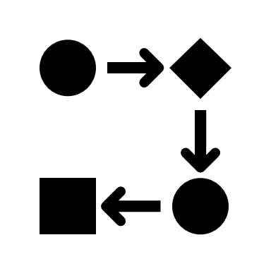
STAGE 1 — CHANGE DETECTION
INPUT
ORCHESTRATOR
STAGING TABLE
STORED PROCEDURE
CHANGE LOG
Edited Workfile
stg_data_in
detect_changes()
Status: Requested
STAGE 2 — DATA QUALITY CHECK
OK
CHANGE LOG
Status: In Progress
STORED PROCEDURE
EXPANDED TABLE
STORED PROCEDURE
expand_requested()
change_expanded
data_quality_check()
NOT OK
CHANGE LOG
DEFECT TABLE
Status: Rejected
Defect ID + Description
STAGE 3 — DATA UPDATE
ORCHESTRATOR
STORED PROCEDURE
EXPANDED TABLE
STORED PROCEDURE
CHANGE LOG
OUTPUT
expand_inprogress()
change_expanded
apply_update()
Status: Completed
Updated Workfile

